Slide 1
A Project Review-II Presentation on BiLSTM-based Indian Legal Case Summarization and Q&A System
Submitted in partial fulfillment of Final Year Computer Engineering Course- Major Project
In
Department of Computer Engineering
By
Prathmesh Dudhale (122B1B078)
Aditya Joshi (122B1B110)
Aaditesh Kadu (122B1B122)
Vedant Kale (122B1B124)
Under the Guidance of
Prof. Sushma Vispute
______________
Department of Computer Engineering PCET’s Pimpri Chinchwad College of Engineering
(A. Y. 2025-26)
1

Slide 2
Problem Revisited
Indian legal judgments are extremely long, complex, and time‑consuming.
Manual analysis is inefficient and error‑prone.
Goal: Build an intelligent assistant for fast summarization and Q&A.

Slide 3
Review I Baseline (BiLSTM)
• Encoder–Decoder BiLSTM with Attention implemented
• ROUGE‑L ≈ 0.71, F1 ≈ 72%
• Works for factual extraction
• Weak for deep reasoning & long context

Slide 4
Limitations Identified
• Limited context window
• Poor multi‑hop reasoning
• Difficulty with complex legal arguments
• Sequential processing bottleneck

Slide 5
Motivation for Transformers
Transformers overcome RNN limitations using self‑attention.
They model global dependencies and enable parallel computation.
Current SOTA for NLP tasks.

Slide 6
Why Hugging Face Ecosystem
• Largest open‑source hub for pretrained models
• Production‑ready implementations
• Easy fine‑tuning & deployment
• Strong community support

Slide 7
Project Objectives (Phase II)
1. Replace BiLSTM with Transformer models
2. Improve summarization quality
3. Enhance QA accuracy
4. Maintain practical deployability

Slide 8
Proposed Methodology
Core Engine (Transformers): Implementation of the Hugging Face ecosystem, moving away from sequential BiLSTM to parallel-processing Transformer models.
Summarization Layer: Utilizing BART-Large-CNN for abstractive summarization to capture the ratio decidendi (reason for the decision) of long legal judgments.
Question Answering Layer: Utilizing RoBERTa-Base-SQuAD2 for extractive QA, specifically chosen for its ability to handle unanswerable questions and reduce hallucinations in a legal context.
Long-Document Handling: Implementation of a sliding window chunking strategy with overlap to process documents that exceed the model's token limits while preserving context

Slide 9
Model Benchmarking Approach
Multiple SOTA models evaluated on Indian legal judgments.
Metrics used:
• ROUGE‑L (Summarization)
• F1 Score (Question Answering)
• Practical suitability

Slide 10
Performance Metrics
Summarization Metric: ROUGE-L The primary metric used to evaluate the BART-Large-CNN model is ROUGE-L.
Definition: It measures the Longest Common Subsequence (LCS) between the machine-generated summary and a human-written reference. Significance: A score above 0.25 in the legal domain is considered highly effective due to the complexity of legal vocabulary.
Our Result: Achieved a score of 0.2775, which is competitive with state-of-the-art benchmarks for Indian judgments.

Slide 11
Performance Metrics
Question Answering Metric: F1 Score For the RoBERTa-Base-SQuAD2 engine, we utilize the F1 Score to evaluate extractive accuracy.
Definition: It provides a balance between Precision (exactness) and Recall (completeness). SQuAD 2.0 Advantage: This metric is particularly useful for our system because it accounts for unanswerable questions, reducing hallucinations.
Our Result: Achieved an F1 score of 0.4044, which was the highest among all benchmarked models for the Indian legal dataset.

Slide 12
Performance Metrics
Practical Evaluation Criteria Beyond mathematical scores, the system is evaluated on:
Narrative Coherence: The ability of the summarizer to preserve the logical flow and the Ratio Decidendi (reason for the decision).
Hallucination Resistance: The model's ability to refuse invalid queries by outputting "Unknown" if a fact is missing from the document.
Inference Speed: The goal is to provide near real-time results for better user experience.

Slide 13
Selected Summarization Model
BART‑Large‑CNN
• ROUGE‑L = 0.2775 (Best among tested models)
• Seq2Seq Transformer
• Strong narrative coherence
Model Link:
https://huggingface.co/facebook/bart-large-cnn

Slide 14
Why BART is Suitable for Law
• Captures long‑range dependencies
• Handles unstructured documents
• Preserves logical flow of judgments
• Extracts ratio decidendi effectively

Slide 15
Selected QA Model
RoBERTa‑Base‑SQuAD2
• F1 = 0.4044 (Highest)
• Fine‑tuned for extractive QA
Model Link:
https://huggingface.co/deepset/roberta-base-squad2

Slide 16
Why RoBERTa Outperformed Others
• Robust language understanding
• Handles unanswerable questions
• Reduces hallucinations
• Better syntax modeling than BERT

Slide 17
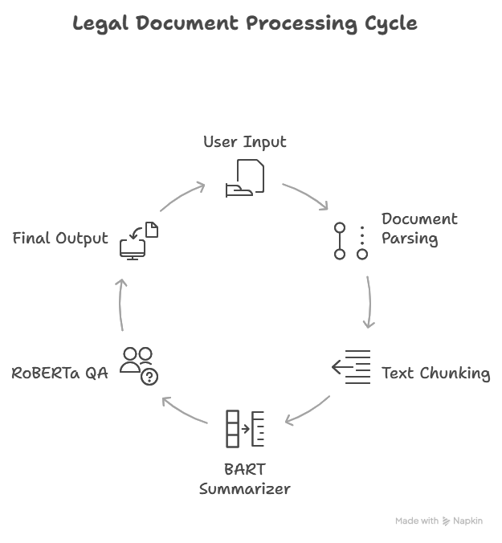
Overall System Architecture

Slide 18
Backend & Infrastructure
• Python + Hugging Face Transformers
• PyTorch backend
• Flask REST API
• MongoDB Atlas database
• Google Colab T4 GPU

Slide 19
Long Document Handling
Legal judgments exceed model context limits.
Solution:
• Sliding window chunking
• Overlap to preserve context
• Summary aggregation

Slide 20
BiLSTM vs Transformer Comparison
BiLSTM:
• Sequential processing
• Limited context
• Moderate accuracy
Transformer:
• Parallel processing
• Global attention
• Higher accuracy & reasoning

Slide 21
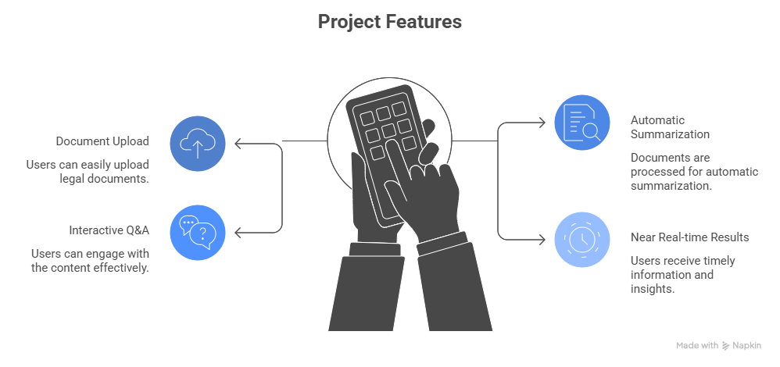
Prototype Implementation

Slide 22
Key Improvements Achieved
• Better semantic summaries
• Improved handling of complex queries
• Reduced information loss
• Scalable architecture

Slide 23
Challenges & Constraints
• High GPU memory requirement
• Context window limits still exist
• Domain adaptation needed for Indian law

Slide 24
Conclusion
Transformer models significantly outperform BiLSTM baseline.
Hugging Face enables practical deployment of Legal AI systems.
This phase establishes a strong foundation for an intelligent legal assistant.

